Slide 1



Magic Company
HUMAN RESOURCES MANAGMENT OPERATIONS IN ORACLE ERP SYSTEM PROJECT
NXT23_ONL2_ERP2_G1
Under the supervision of Engineer Hassan Amgad.

Slide 2


Introduction
We are your trusted partner in Oracle ERP Systems implementation, helping businesses streamline operations with a secure, all-in-one platform. Oracle ERP integrates core business processes, automates workflows, and ensures controlled access based on user roles, making data management more efficient and secure.
Our expertise in the Human Resources Management (HRM) module enables businesses to handle employee records, payroll, and performance evaluations with ease. By automating these processes, companies can reduce errors, stay compliant, and improve overall efficiency.
With powerful data analytics and real-time insights, Oracle ERP empowers organizations to make smarter decisions and stay ahead of the competition. We are dedicated to ensuring a smooth implementation, comprehensive user training, and long-term success for your business.

Slide 3


Team Members
Lamiaa Ramzi
Weam Mohamed
Moustafa Mohamed
Marian Hany
Abdelrahman Hassan
Kareem Haseen

Slide 4

We are a company specializing in developing applications for Oracle systems, currently working on implementing the application in three phases:
Phase 1: Employee Data and Payroll Setup ​
(A) Employee Records Management (Lamiaa Ramzi)
(B) Organizational Structure Setup
(C) Payroll Setup (Weam Mohamed)
(D) Personal Payment Methods

Slide 5
Phase 1: Employee Data and Payroll Setup​
(A)Employee Records Management
​(B)Organizational Structure Setup
First, we start with employee registration. We create a new employee profile, entering essential details such as name, job title, and department assignment. Then, we establish the organizational structure by defining departments, job roles, and reporting lines. Once the structure is in place

Slide 6
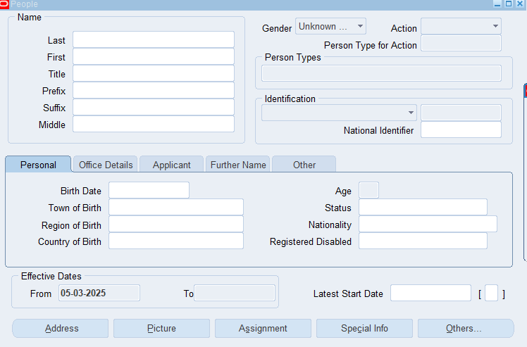
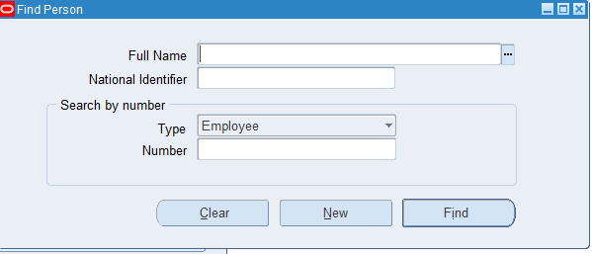
Create an employee profile (Name, Job Title, Department).​
Employee Profile Interface
This interface displays the employee's profile. It is essential to fill in the required fields with accurate employee information, including: Personal Information: First and last name, national ID number, and nationality.
Job Details: Job title, specialization, and reporting line
All fields must be completed to ensure a comprehensive employee database.
Here, you can enter the system-assigned number to easily find the employee's profile.

Slide 7
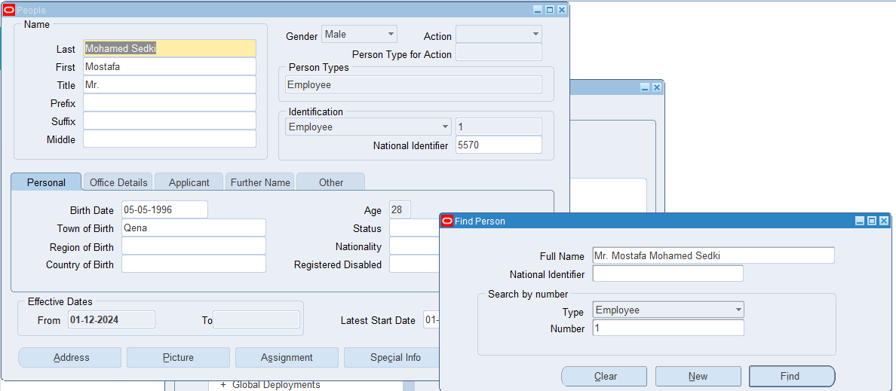
In the illustrated example, we can see an employee Moustafa Mohamed and some of his information. We were able to find his profile easily by entering the number 1 in the "Find People" search field.

Slide 8
(B) Organizational Structure Setup
Here are the steps to achieve and establish an organized hierarchical structure for company management:
1-Create a Business Group
3-Create Section
5-Create Job
7- Position Hierarchy
2-Create Department
4-
Organization Hierarchy
6-Create Position

Slide 9
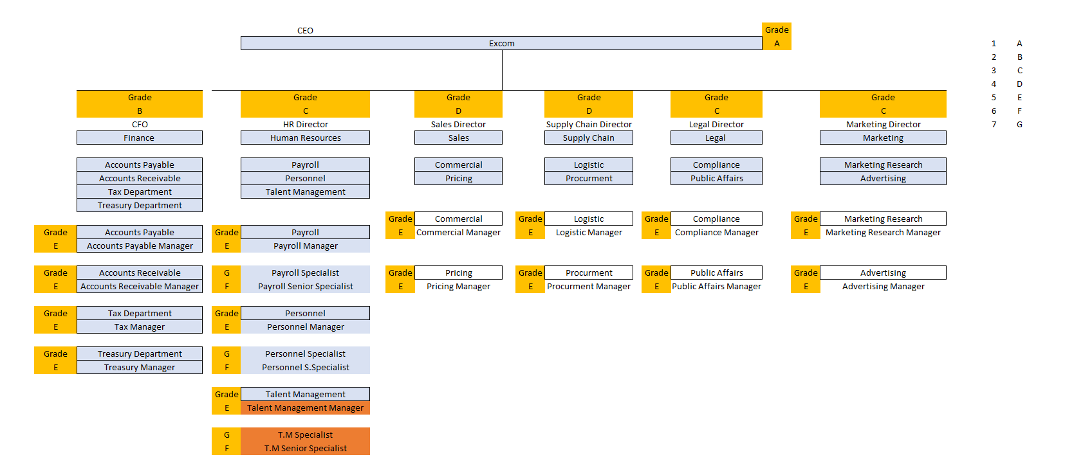
I had an Excel sheet containing the company's organizational structure (data like departments ,sections,position ), and I applied this approach to create appropriate job titles for each employee

Slide 10
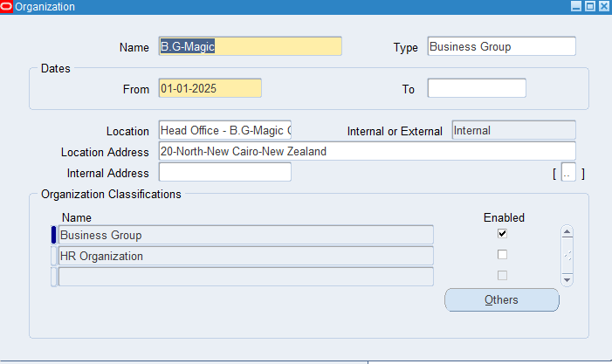
1-A Business Group in Oracle is the highest-level organization that helps structure HR, finance, and compliance. It ensures data security, supports multi-organization management, and handles legal and payroll requirements separately. This makes operations more organized, secure, and compliant across different regions.
The interface shows the creation of a Business Group named [B.G-Magic].

Slide 11
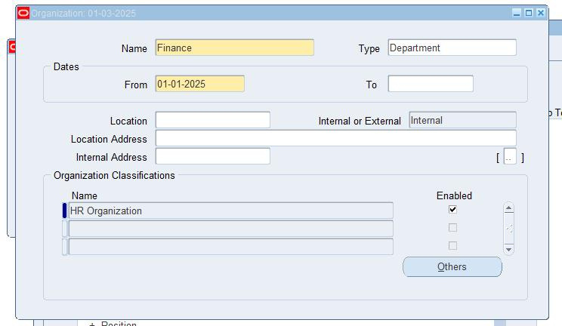
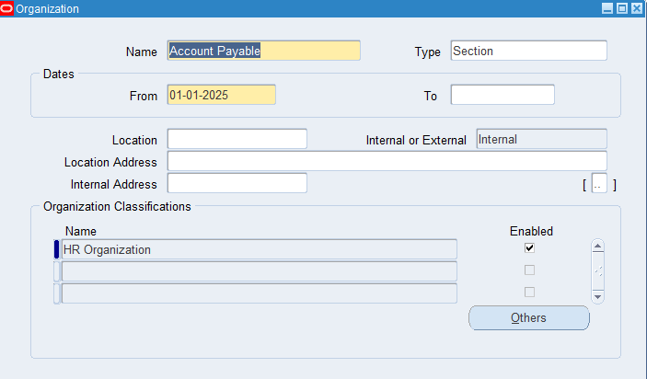
2-The interfaces show the creation of a DEPARTMENT OR SECTION by entering the name and selecting the type.
2-name :Finance type:Department
3-name: Account payable type:section

Slide 12
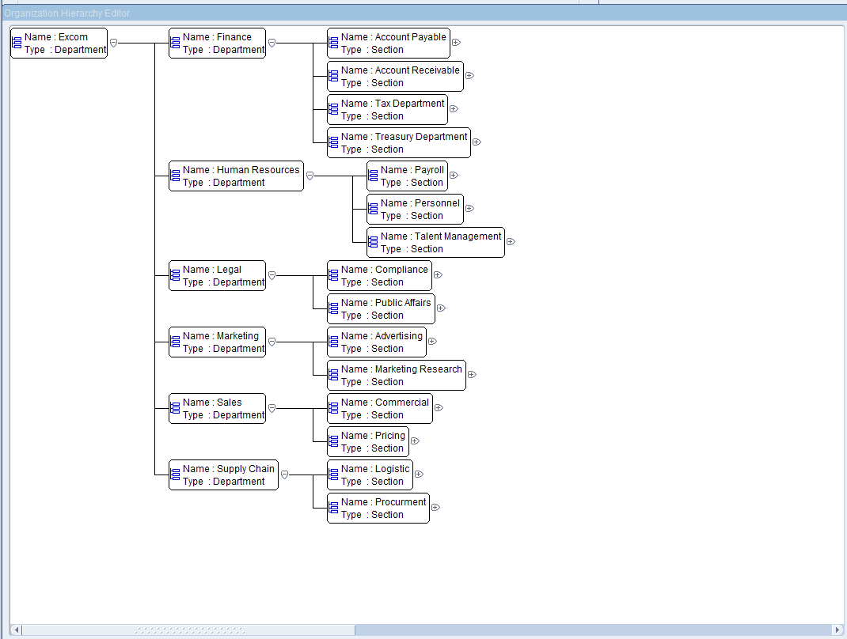
After creating each department and section based on the received Excel sheet and other provided examples, we can now build the organization's structure within the system.The illustrated diagram demonstrates the hierarchy, starting from the top-level department, followed by its sub-departments, and then each section under its respective department.

Slide 13
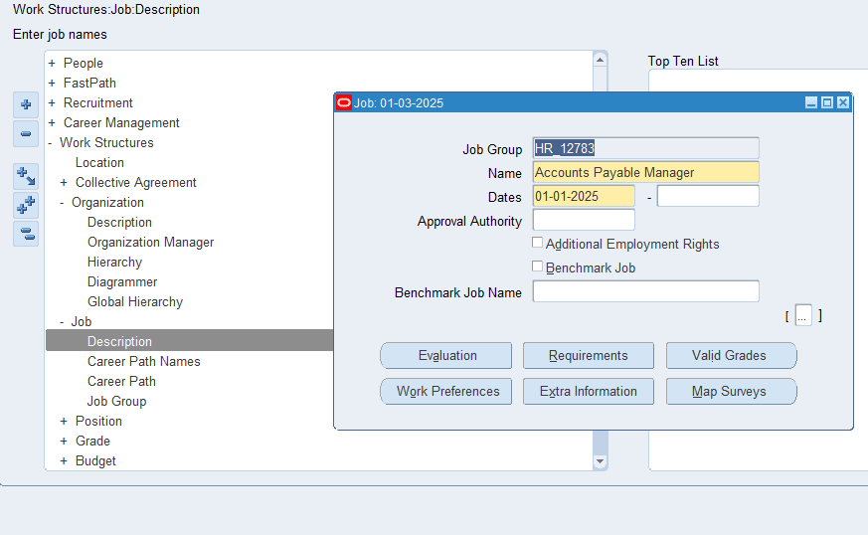
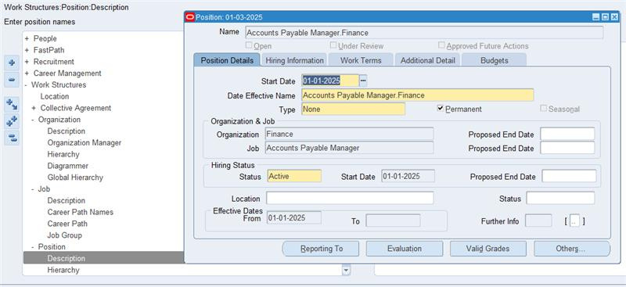
To create a job title, we collect and analyze data from the company, then define the position based on a combination of the department and job title. This approach ensures that each employee receives an appropriate designation aligned with their role within the organization
4-"Create job title."
5-"The window shows the creation of a position."

Slide 14
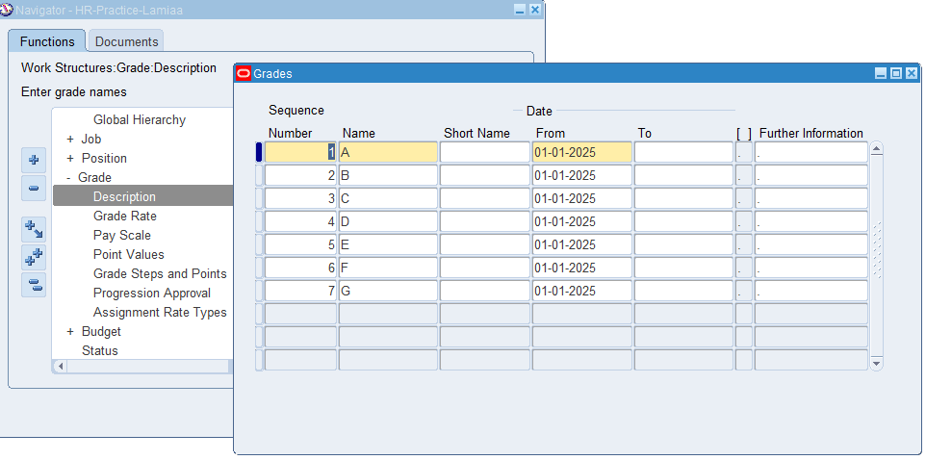
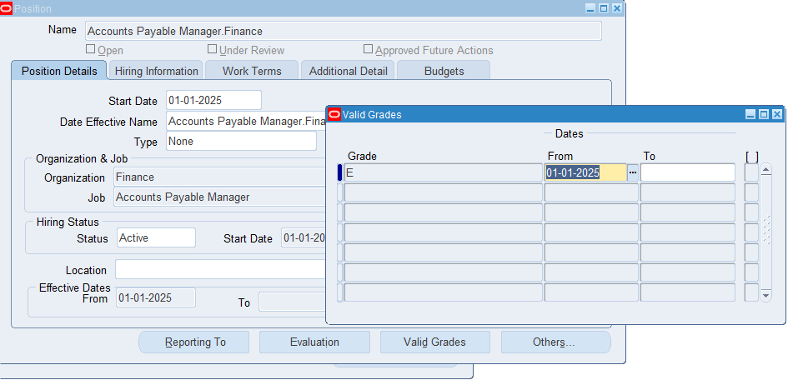
"I have created seven grads levels and linked each position to its corresponding level based on the organizational chart provided in the Excel sheet
Create Company Grades
I have assigned grades to the positions.

Slide 15
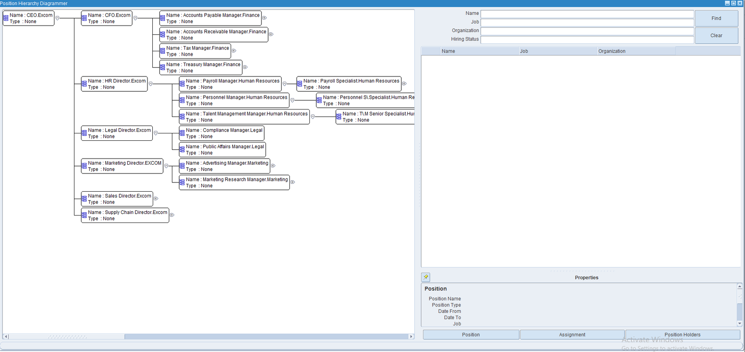
The primary purpose of defining a position is to clarify the reporting structure, ensuring that each employee knows whom they report to, their job title, and the department they are assigned to
This is a Position Hierarchy Diagram in the Oracle ERP system, showing the company’s Position structure

Slide 16
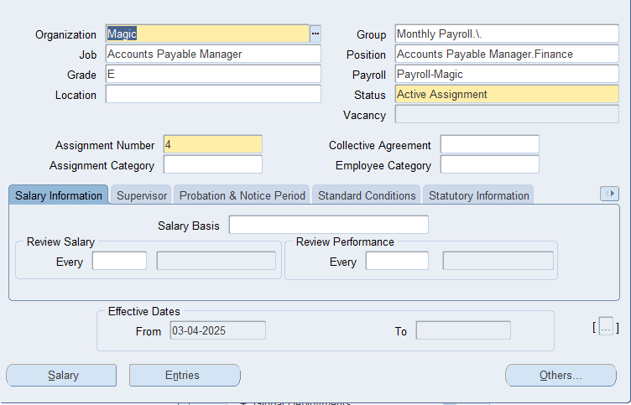
As a final step, we included the job title, grade, position, and department in the previously created employee profile as an example. This ensured that everything is accurately set up in the system

Slide 17


(C) Payroll Setup & (D) Personal Payment Methods
Payroll in Oracle ERP system automates salary processing, ensuring accurate calculations for earnings, deductions, and taxes. It integrates with other HR modules to streamline payments and reduce manual work.
Here are the steps to create the company's payroll setup:
1- Create Element
2- Create Element Link
3- Create Element set
4- Payroll Calendar
5- Define Payment Method

Slide 18
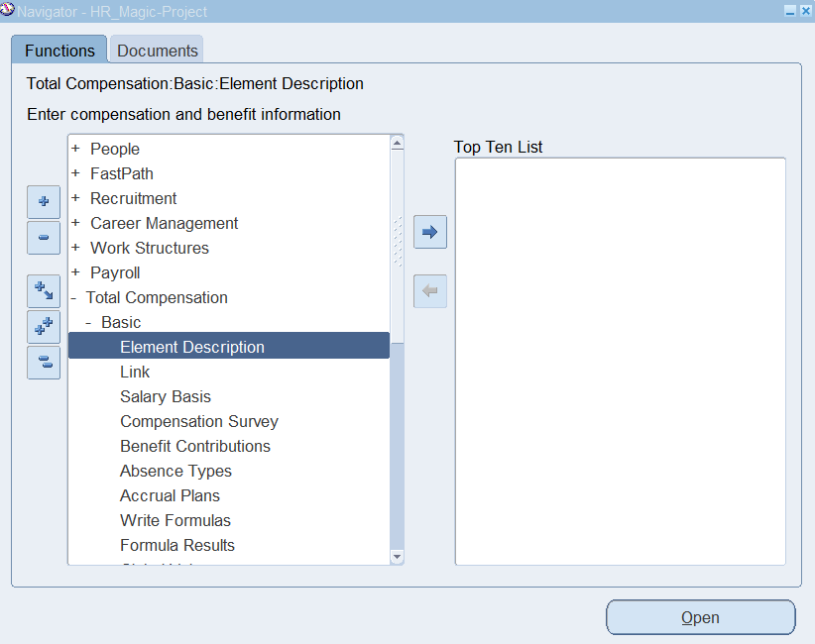
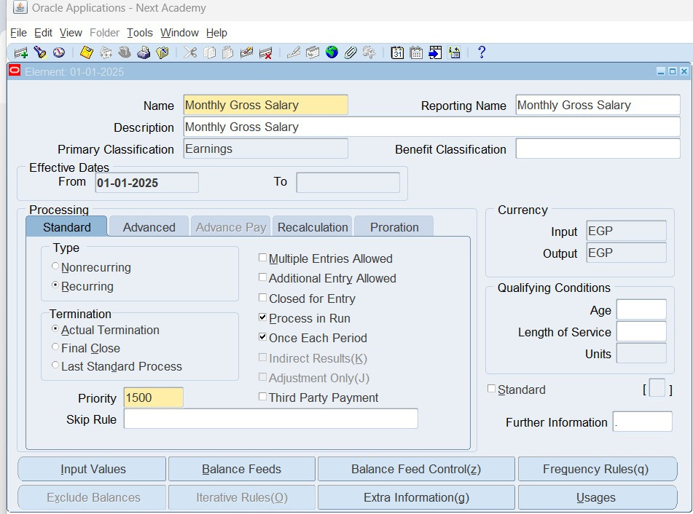
1- Create Payroll Elements
Set up Payroll Elements such as Monthly Gross Salary, Monthly Tax , and Monthly Social Insurance.
Element Name: Monthly Gross Salary
Element Type: Earning refers to the process of adding monetary compensation to an employee's payroll.

Slide 19
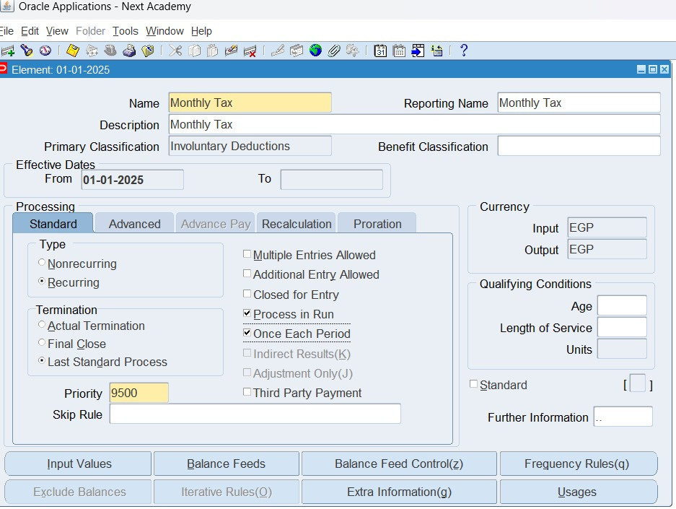
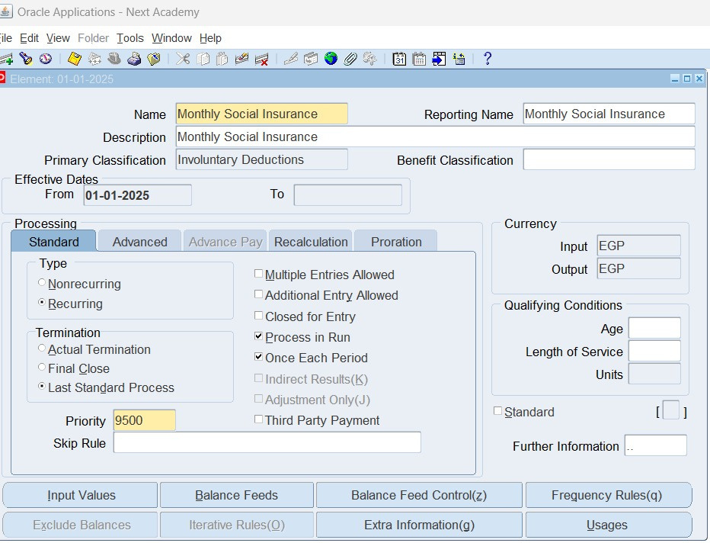
Element Name: Monthly Tax
Element Name: Monthly Social Insurance
Elements Type: Involuntary deduction refers to mandatory amounts withheld from an employee's salary, such as taxes and social insurance.
These three elements are standard, and recurring .
Standard elements apply to all employees
Recurring elements are automatically repeated without the need for manual entry each time.

Slide 20
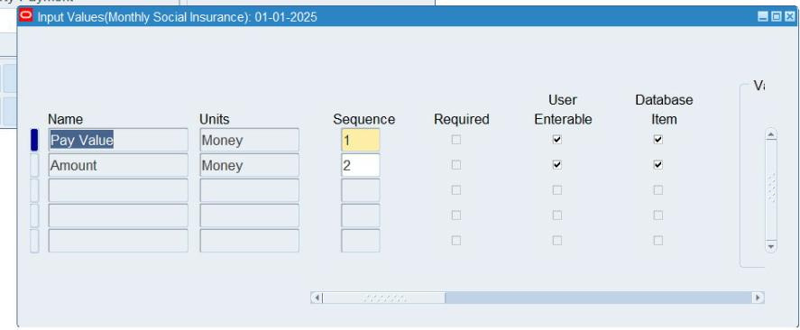
And add a value named (Amount) from input value for the three elements

Slide 21

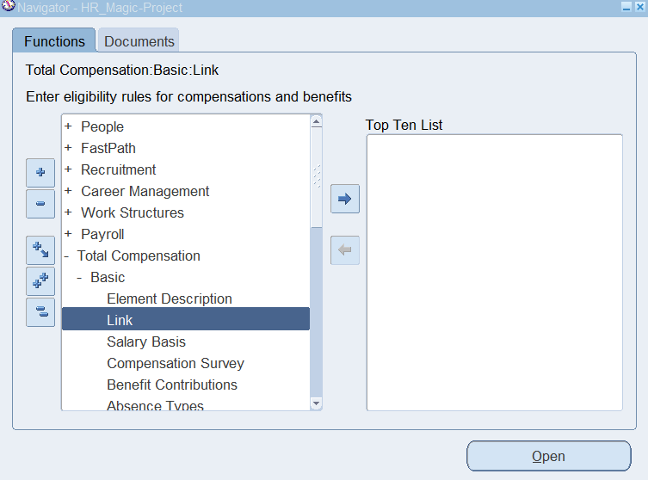
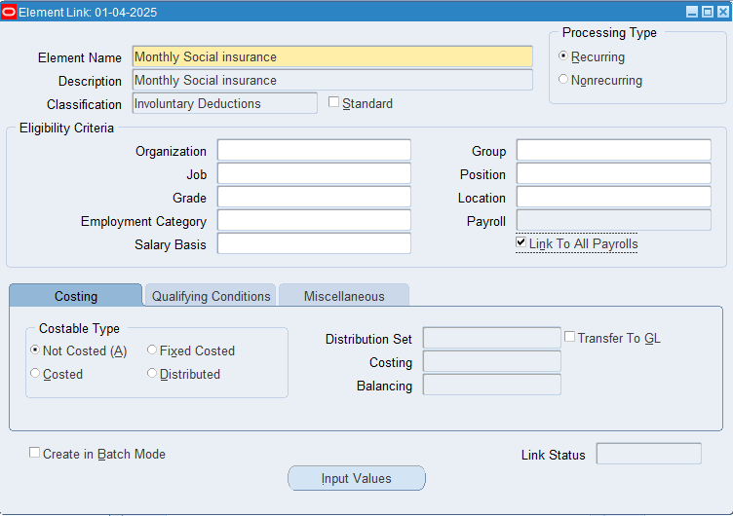
2- Create Element Link
An Element Link defines the criteria for assigning specific payroll elements to employees within the company's payroll system. It determines which employees are eligible for a particular element based on factors such as job roles and grades, ensuring accurate and consistent payroll processing.

Slide 22
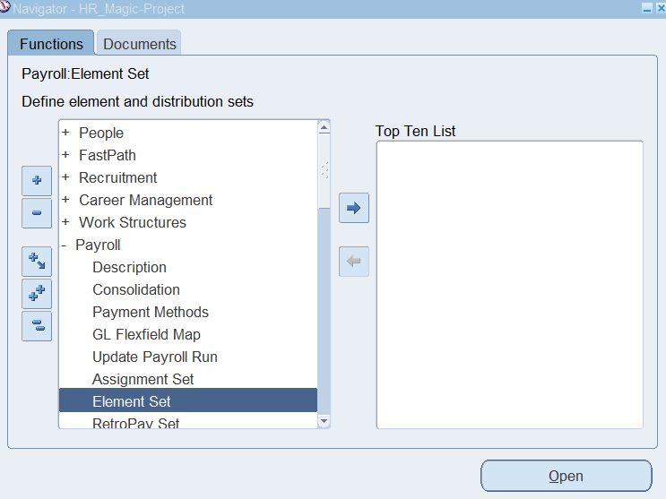
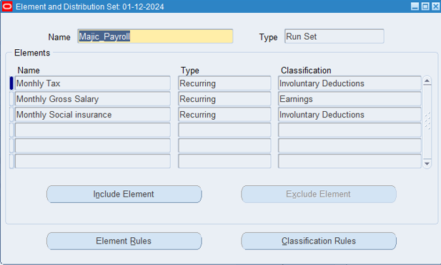
3- create Element set
An Element Link defines the criteria for assigning specific payroll elements to employees within the company's payroll system. It determines which employees are eligible for a particular element based on factors such as job roles and grades, ensuring accurate and consistent payroll processing.

Slide 23

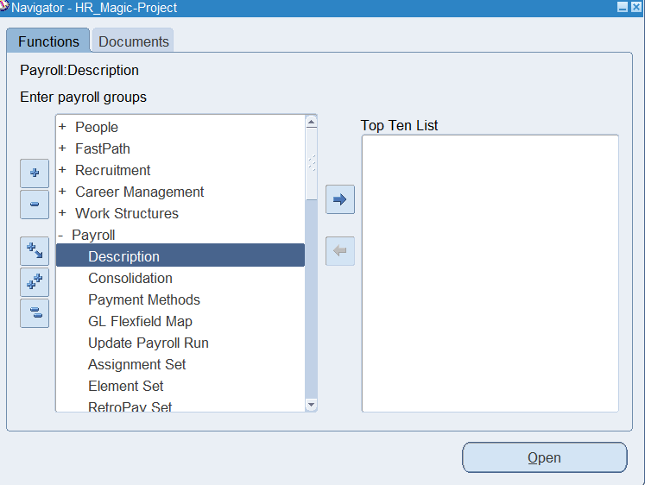
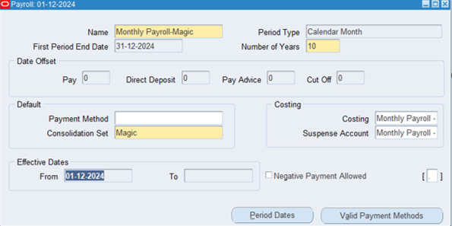
4- Payroll Calendar
A Payroll Calendar is a schedule that defines payroll processing dates, including pay periods, cutoff dates, and payment dates. It helps ensure timely salary payments, compliance with company policies, and efficient payroll management.

Slide 24
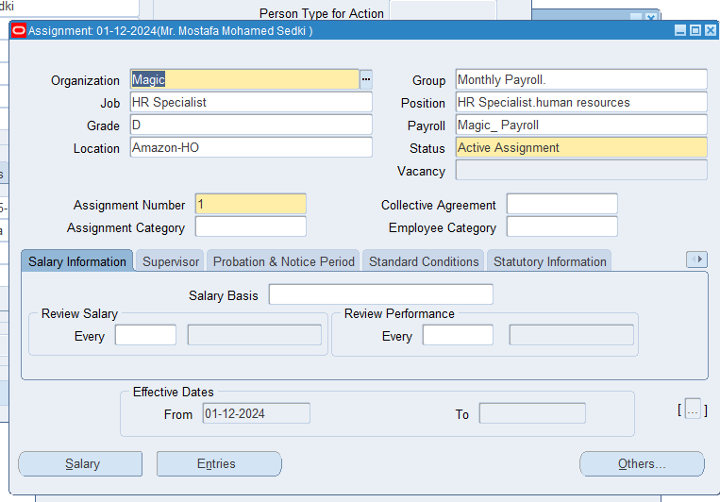
Add Payroll Calendar to the employee
Assigning a Payroll Calendar to an employee sets their payment schedule, ensuring salaries are processed correctly and on time. All employees linked to a payroll calendar will receive its associated payroll elements.

Slide 25

5- Define Payment Method
Before creating a Payment Method, we first need to set up a Payment Type.
The Payment Type setup defines how employees receive their salaries each month, either through
Cash
Bank
Bank Transfer is the preferred option as it is more secure and reduces manual entry. Since the Payment Type has already been set up, we can proceed directly to configuring the Payment Method.

Slide 26
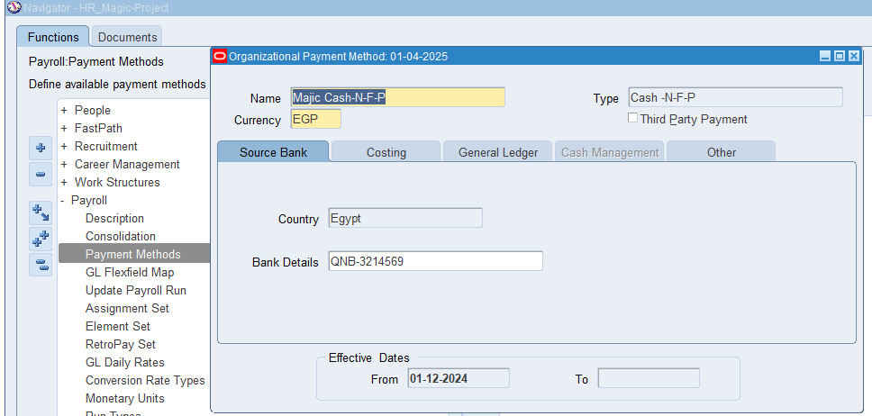
Then, we created a Payment Method.
A Payment Method defines how employees get paid, making the process more flexible, automated, and compliant. It helps reduce errors, improve security, and ensure salaries are paid accurately and on time.

Slide 27
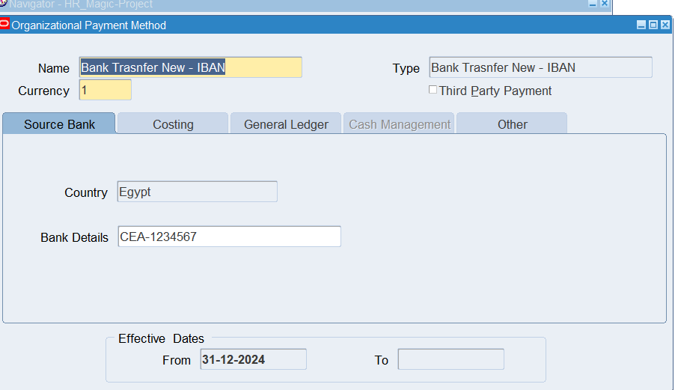
Also create A bank payment method that refers to any way of transferring funds through a bank.

Slide 28
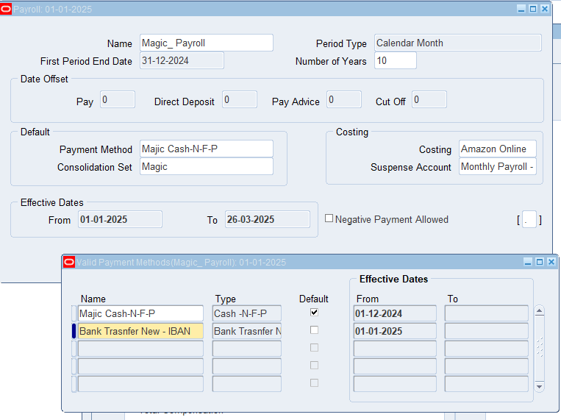
Link the payroll calendar with payment methods ensures that employees receive their salaries correctly and on time. By setting up this link, the system knows when to process and transfer payments based on the scheduled payroll dates. This helps automate salary payments, whether through direct deposit, bank transfers, or checks, making the process smoother and more reliable.

Slide 29
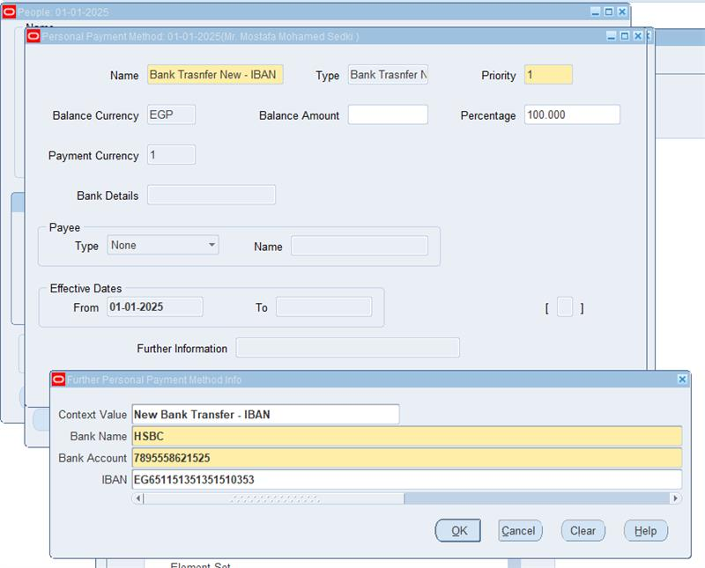
The Two Personal Payment Methods have already been assigned to all company employees.

Slide 30
Team responsibility Task division& Phase 2: Payroll Processing and Leave Management
1) Payroll Processing
(Moustafa Mohamed)
2) Leave and Absence Management
(Marian Hany)
3) Employee Benefits Management
(Marian Hany)
4) Adjustment and Correction
(Moustafa Mohamed)

Slide 31
Phase 2: Payroll Processing and Adjustments
1- Payroll Processing:
Payroll processing for all employees refers to the process of calculating and distributing salaries or wages comprehensively for a specific pay period. Payroll processing for all employees refers to the process of this Step involves executing payroll calculation to determine salaries, bonuses and deductions based on predefined rules. Here, we ensure accuracy by validating employee data, tax regulation, and benefits.

Slide 32
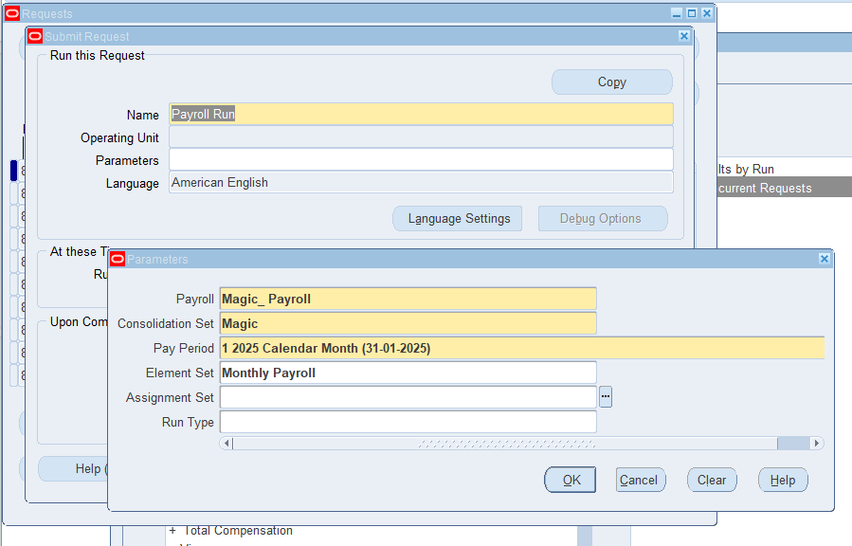
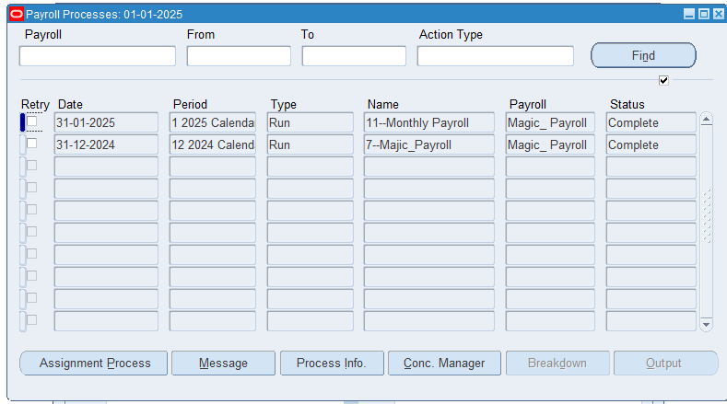
A- Processing the payroll run for all employees
view – Payroll run request
payroll process
•Payroll Calendar Name: Magic_Payroll.
•Consolidation Set: Magic.
•Pay Period: 01 -01-2025 Calendar Month (31-01-2025).
•Element Set: Monthly Payroll.

Slide 33
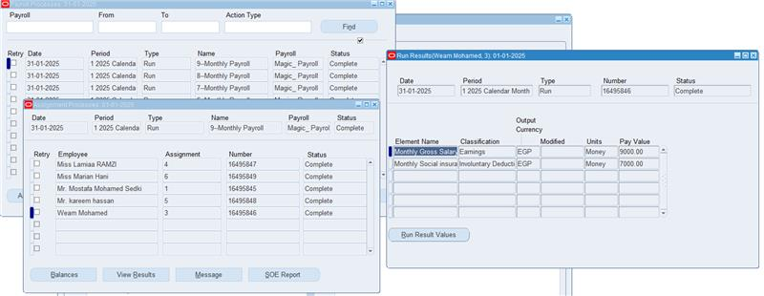
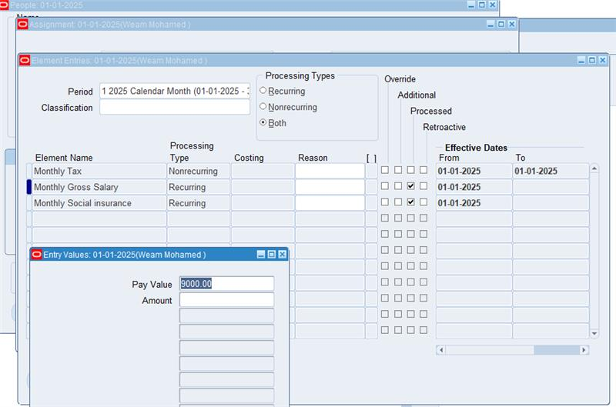
B- Review the calculated salaries, bonuses, and deductions for accuracy.
we are reviewing calculated Calculate Gross Pay Hourly wages or salary Overtime pay Bonuses, incentives, or allowances could be done through the 3 next stages:
Stage 1
Assignment Processes
stage 2
view Run Results
stage 3
Input Value

Slide 34
C- Generate and distribute employee payslips :
After data processing, this is a crucial step in payroll processing, ensuring that employees have detailed records of their earnings, deductions, and benefits, including regular pay and any additional earnings such as bonuses, overtime, commissions, tax deductions, social security contributions, health insurance premiums, retirement contributions The developer sends this data to employees as a notification through employee self-service, ensuring they receive accurate information about their salaries. By creating and distributing payroll, the system automates the creation and processing of payrolls, allowing for secure and efficient distribution to employees. This process enhances transparency and simplifies payroll management.

Slide 35
2- Leave and Absence Management (Involves Roles for Vacation , Sick Leave And other absence based on Company Policy and Labor Low’s
1-Create Element discerption (Annual Leave)
3-Absence Type
2- Create Element Link for (Annual Leave) Element
4-Create Accrual Plance

Slide 36
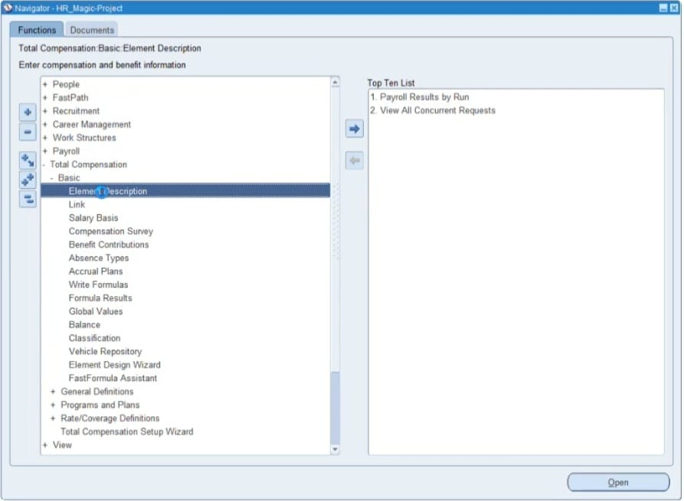
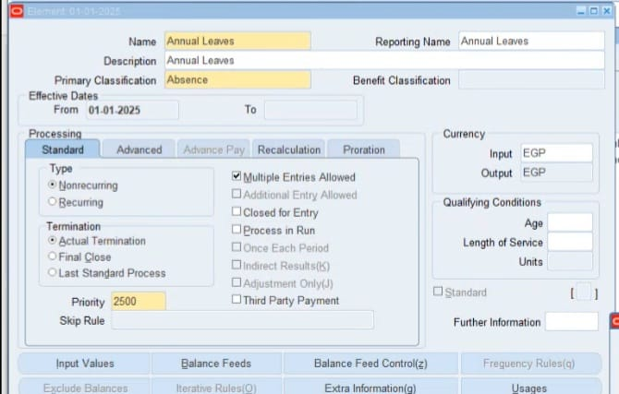
1-Create Element discerption (Annual Leave)
1st Select the name (Annual Leave) Then chose absence (non recurring) then chose (Last standard Process) Finally add input value’s(Days)

Slide 37
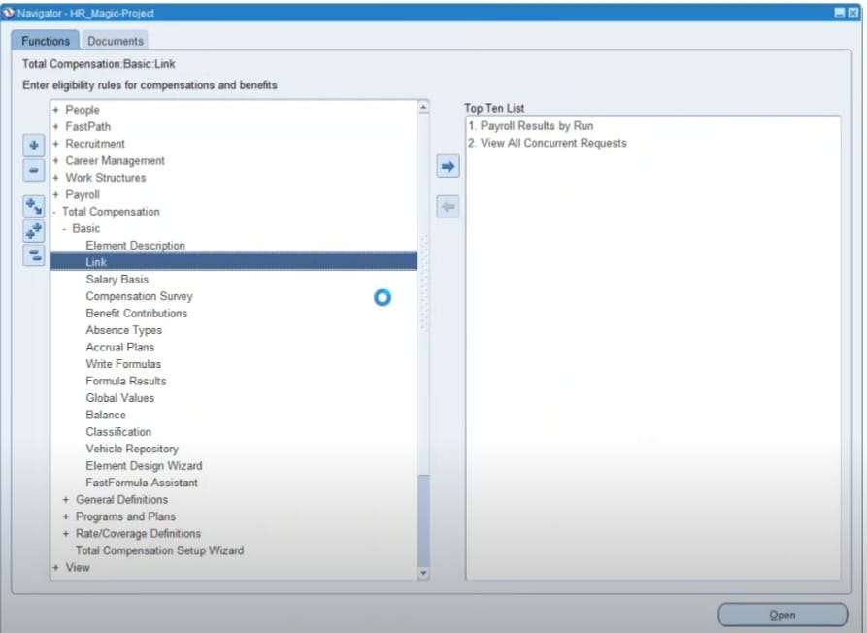
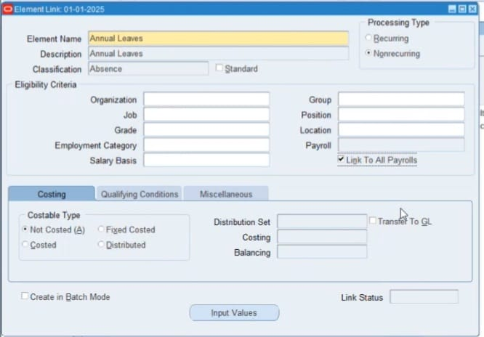
2- Create Element Link for (Annual Leave) Element
1st chose Annual Leave Then chose Absence then Non-Recurring finally select Link to all Payroll to link it to payroll

Slide 38
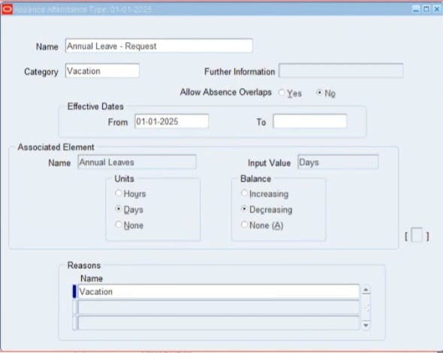
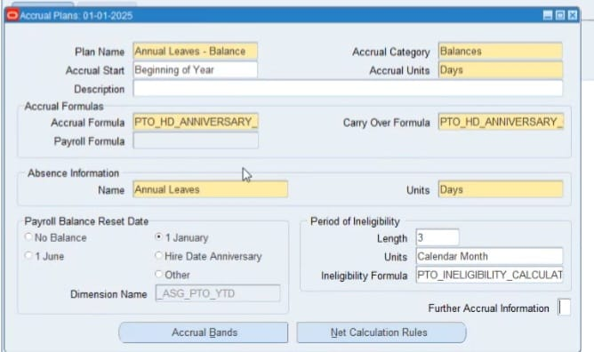
3-Absence Type
4-Create Accrual Plance
1st Define absence type then select annual Leave then chose vacation , days Finally chose decreeing
1st Select annual leave accrual plan , vacation ,chose begging of year Finally chose day’s

Slide 39

4- Adjustments and Corrections Handled:
sometimes it is necessary to make corrections to payroll run
after running a payroll and viewing the results you can make corrections, adjustment and changes when the payroll process require this by using of process like:
Action | What to use | Example
Retry | Resubmit records marked for retry or in error | You didn't update a formula for an earnings element before calculating the payroll. You do the following steps: Correct the formula and recompile it. Retry the Calculate Payroll task. The application calculates any records that include an entry for that earning.
Roll back | Delete all the records processed by the task | While reviewing run results, you discover an error in a person's record that requires additional research. You do the following steps: Roll back the person's record to remove it from the payroll run Correct the error. Submit a QuickPay flow to calculate the payroll for the person.

Slide 40
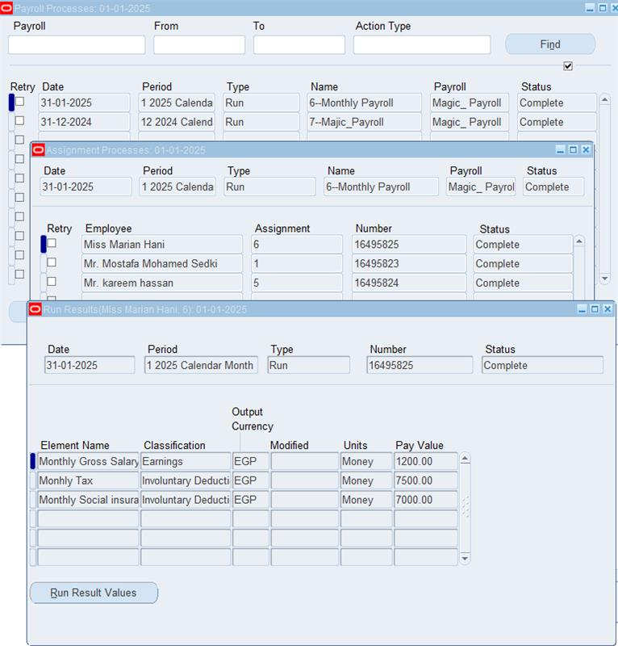
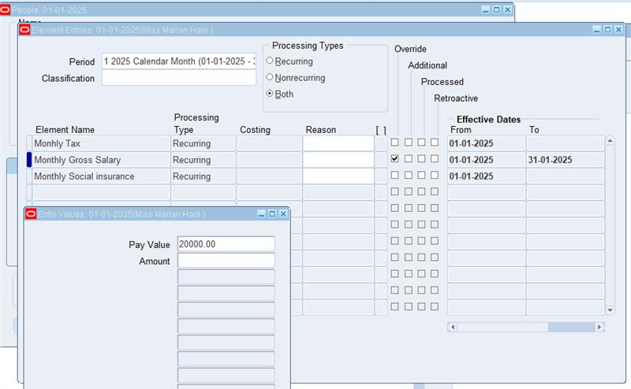
A) Retry Payroll Run“
find the process and mark it for retry:
Enter the name of the payroll field and the period rang in the form and to fields and click on the find button
Place the current record indicator (blue box) next to the process you want to retry and place a check in The retry checkbox
Save your work and close window
Saving the transaction marks the process for retry the status should then say marked for retry
Payroll processes results (Miss Marian Hany) Before retry Run

Slide 41
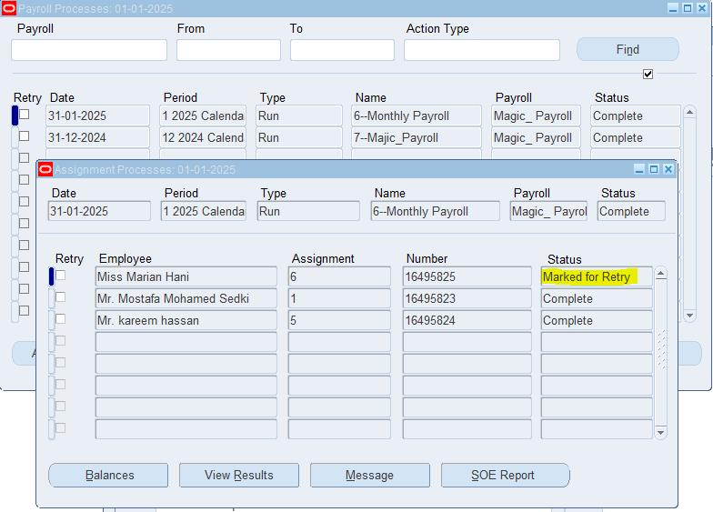
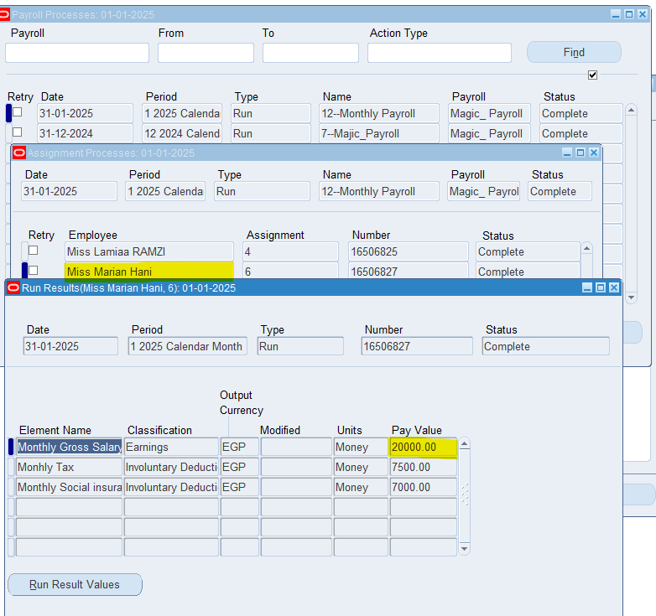
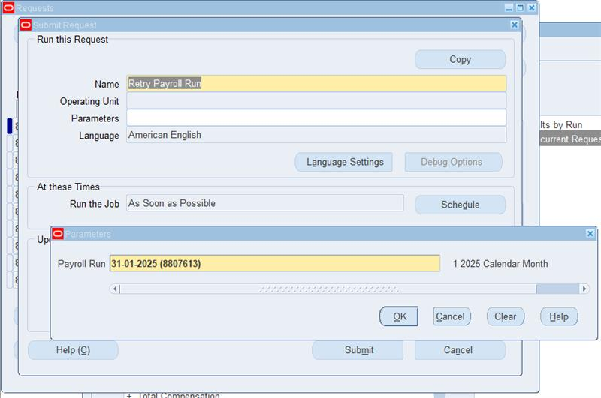
The Payroll Processes results after retry run
Submit retry payroll run

Slide 42
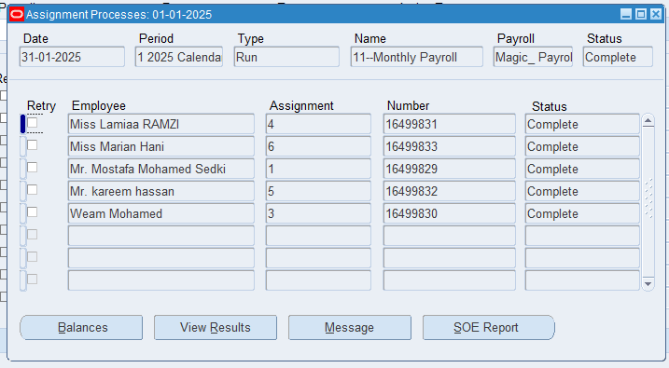
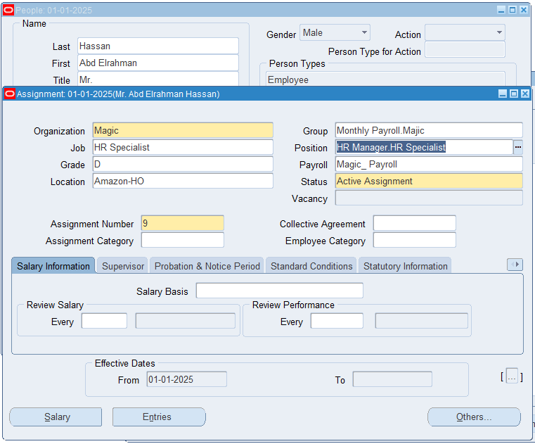
B) "rollback run":
Making necessary adjustments and reprocessing retrieved payroll data is a process in Oracle Payroll that allows the user to reverse a payroll process and delete its results. This process is useful when payroll is processed correctly, such as when incorrect data is entered, employee data is changed, a new employee is added, or an employee is terminated. The system recalculates payroll based on the new changes.
the payroll process results before adding the new employee
adding the new employee to the payroll Group

Slide 43
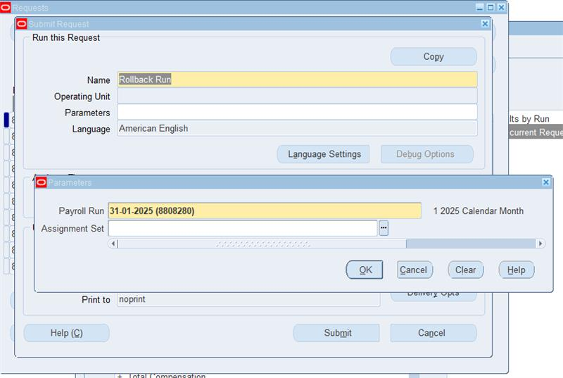
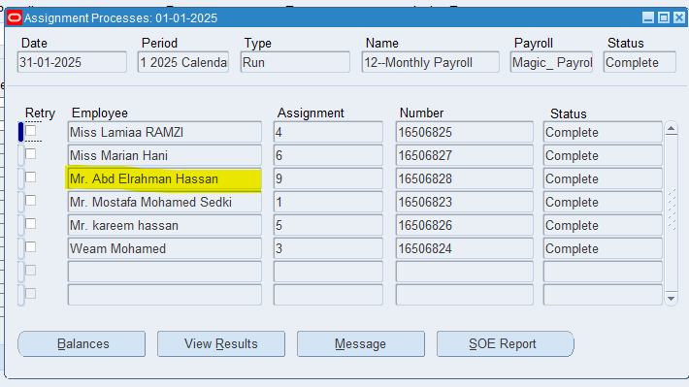
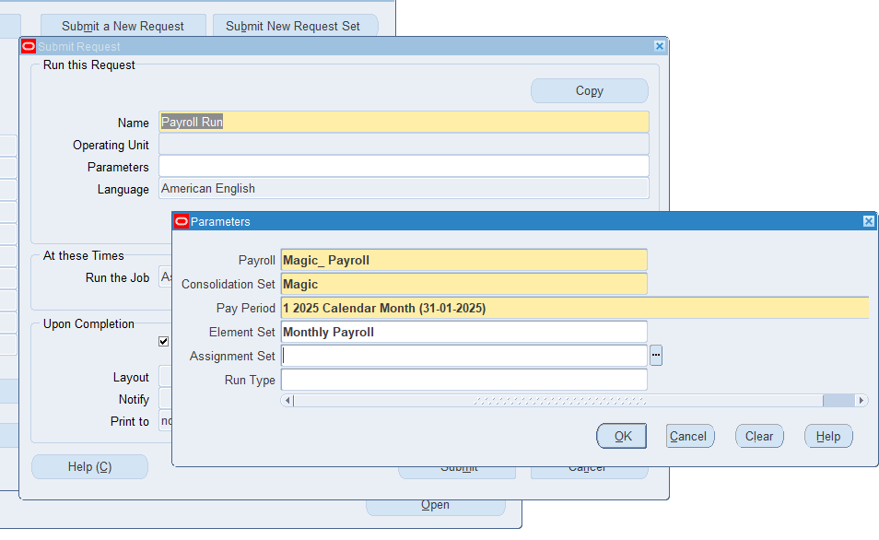
Submit the rollback Run Request
The payroll results after adding the new employee
Submit the payroll run request after adding the new employee

Slide 44
Phase 3: Performance Management and HR Reporting ​
Objective: Enhance employee performance management, track development,
and generate HR reports for strategic decision-making
Key Tasks Overview
(A) Performance Appraisals (Abdelrahman Hassan)
​
(B) Employee Training and Development ​
(C) HR Reporting (Kareem Haseen) ​
(D) HR Period-End Close ​

Slide 45
1-Performance Appraisal
2-Employee Training and Development
➢Training and development programs help employees improve performance, close skill gaps, and boost productivity, giving companies a competitive edge. A training record is a documented record of an individual's completed training.
➢It includes details of courses and learning activities undertaken by an employee or officer. The developer will customize a report listing all the trainings in the company, per employee including the number of hours for each and whether they are related or unrelated to the employee’s job.
➢Setting Up a Performance Review Template
•A performance review template is a valuable tool used by managers and HR professionals to objectively assess an employee's work performance. This template helps identify an employee’s objectives and achievements facilitating their professional growth and development.
• Managers typically use a structured template to guide them through the evaluation
process by focusing on specific performance criteria.
➢Key Components of the Template:
• Performance classification based on criteria such as Excellent, Good,
Satisfactory, or Unsatisfactory.
• Setting performance objectives and expectations for future improvement.
• Providing feedback and recommendations to enhance employee performance.
• Employee and reviewer signatures to confirm acknowledgment and agreement
on the evaluation.
• The recorded rating is a performance assessment at the end of the appraisal period, including a summary rating: good, high, or outstanding performance.

Slide 46
3-HR Reporting
HR reports provide essential insights into workforce data, including employee headcount, payroll summaries, and leave balances.
To make well-informed decisions regarding workflow planning, it is crucial to review and analyze these reports by:
• To help the organization to take the right decision on the right time.
•Assessing workflow efficiency
• Evaluating communication and collaboration effectiveness.
4-HR Period – End Close
Before closing the HR period, it is important to verify that all employee, payroll, and performance-related data have been processed. This process can be conducted monthly or quarterly to ensure that all records have been reviewed and confirmed. Key steps include: Running final payroll and HR reports for reconciliation with the general ledger. Ensuring payroll processing is completed. Conducting a final review and approval. Exporting and recording data in the general ledger.

